Slide 1


Simulating Traffic Prediction on Urban Road network using ML
SUPERVISOR
Dr.Irfan ul haq
PRESENTED BY
Haseeb Sarwar
Rimsha Azmat
Department of Computer and Information Sciences - DCIS
Final Year Project (FYP) Presentation - 2024

Slide 2



CONTENTS
Introduction
Web App
Technology Stack
Machine learning Algorithm
Results

Slide 3
1. INTRODUCTION

Slide 4

Project Overview
Web App
SUMO Intergration
Machine Learning Algorithm

Slide 5

2. Web App

Slide 6
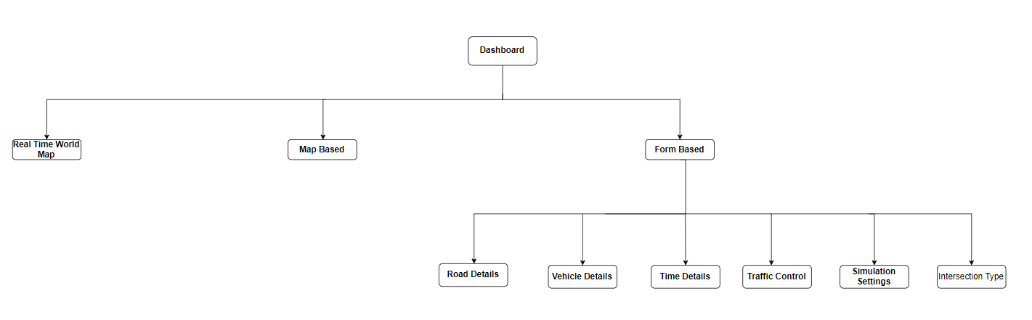

How its work

Slide 7
3. TECHNOLOGY STACK

Slide 8






TECHNOLOGY STACK

Slide 9

Algorithm: Gradient Boosting Regressor

Slide 10
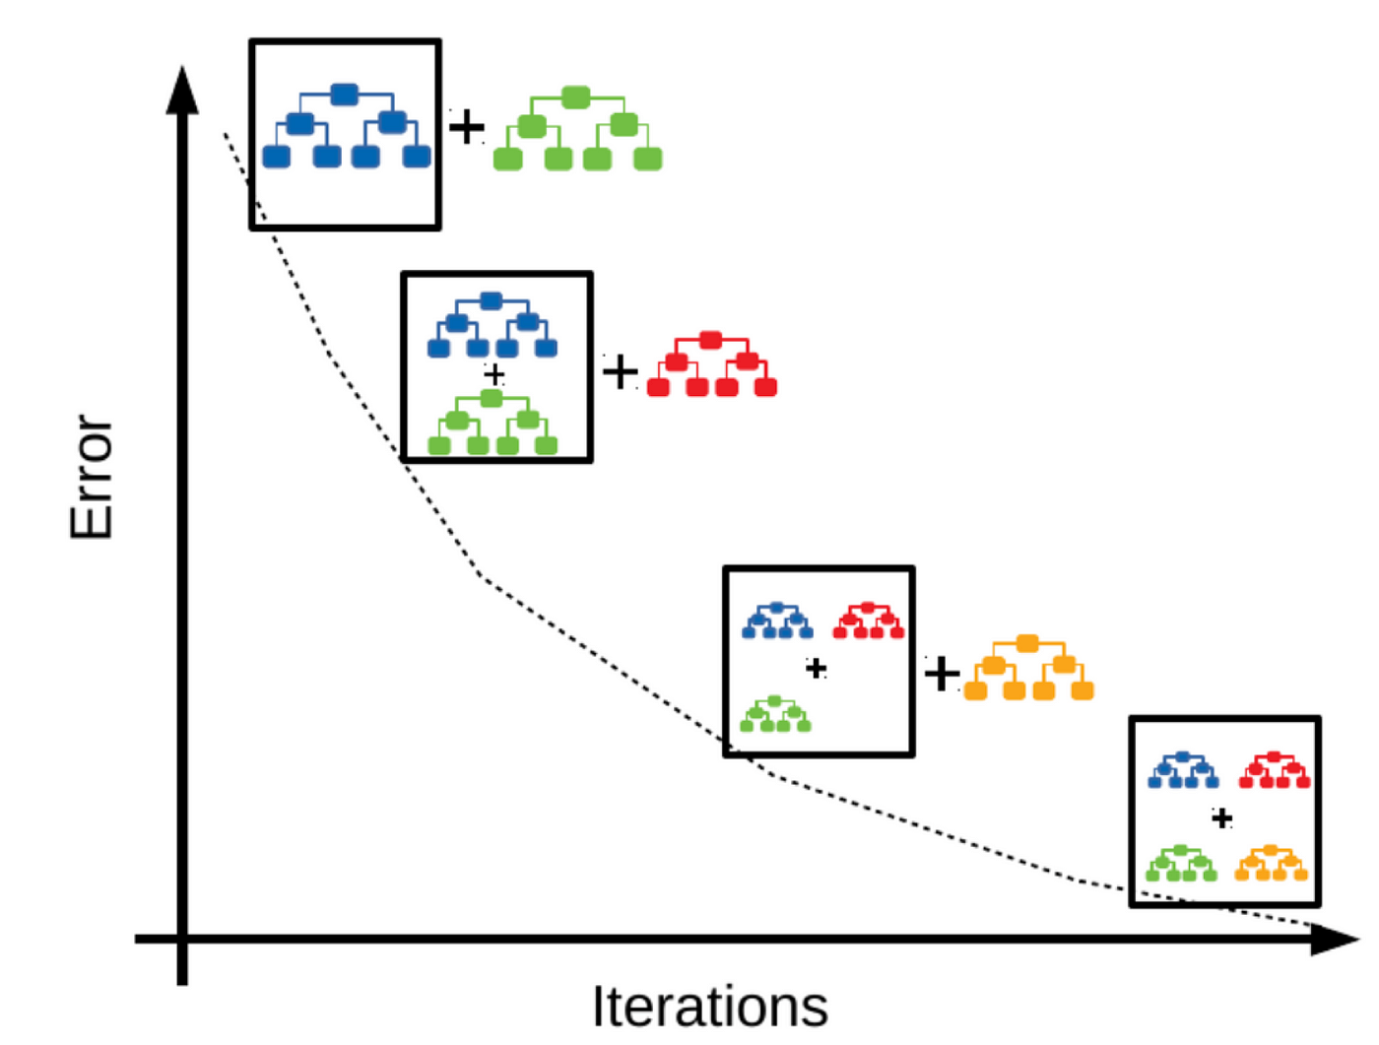
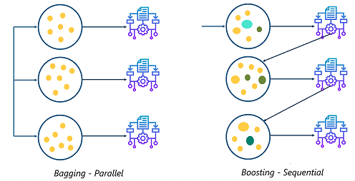

Slide 11
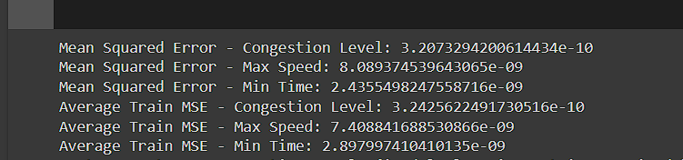
5. Results

Slide 12

8. Remaining Tasks

Slide 13

Development of Map Based Tool.
Connection With SUMO
Final Testing of Algorithm and Web Application

Slide 14

9. Demo

Slide 15


